Slide 1
Hackathon
Implementation of the CDE semantic model for ERNs
June 23 & 25, 2020

Slide 2
Outline
Setting the Scene
Objectives
Approach

Slide 3
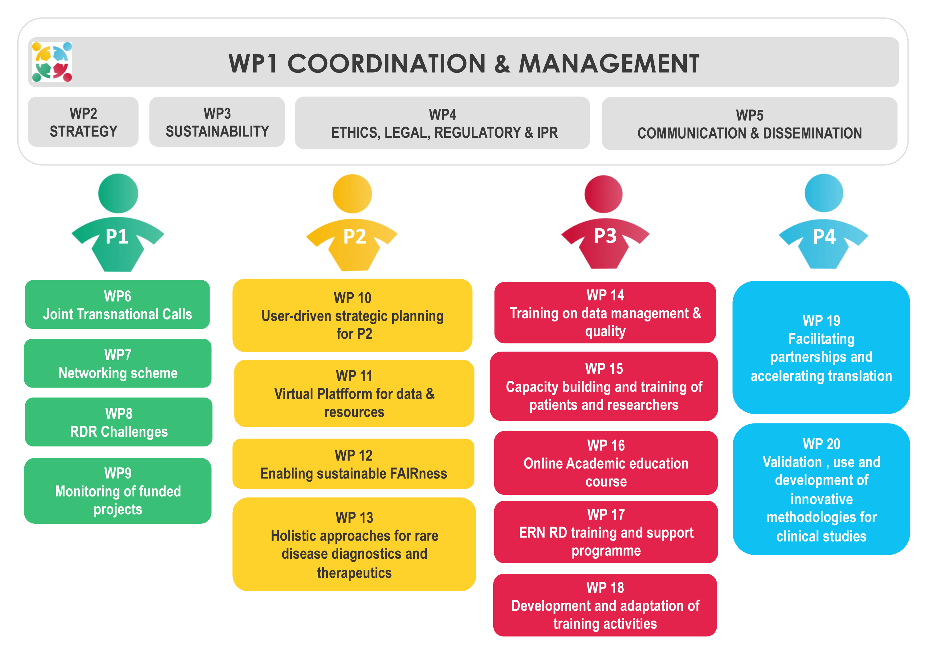
Setting the Scene

Slide 4
Setting the Scene
March 30-31, 2020 – Workshop on Catalogue cases
Calatogue-level metadata model
April 1-2, 2020 – FAIRathon
Functional & Non-functional Requirements for the Virtual platform
April 23-24, 2020 – CDE Model Hackathon (Technical)
Deliver “minimal viable product” or “draft standard for trial use”
June 23&25, 2020 – Hackathon – Implementation of the CDE semantic model for ERNs

Slide 5
Objectives
Co-creation of guidance on applying and using the Common Data Elements (CDE) semantic model
Provide developers of Electronic Data Capture (EDC) solutions with basic (RDF) knowledge that allows for implementation of the model in Electronic Data Capture systems for ERNs’ registries

Slide 6

Co-creation
ERN-representatives – domain knowledge; “customers”
EDC developers – practical technical skills & knowledge
Semantic (web) modelers – conceptual knowledge of RDF representation and modeling

Slide 7
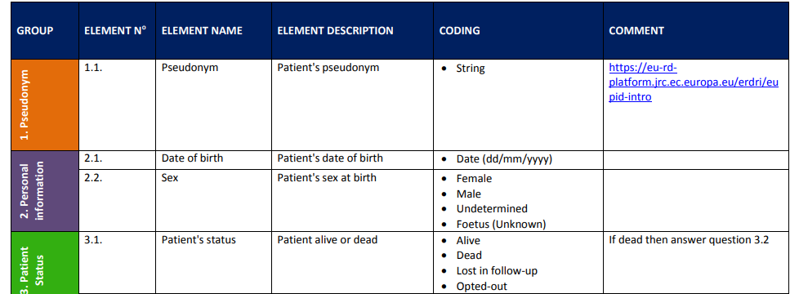
Ingredients (I)
“Set of common data elements for Rare Diseases Registration”
produced by a Working Group coordinated by the JRC (European Commission Joint Research Centre)

Slide 8

Ingredients (II)
ERN BOND | bone disorders (Factsheet - Website)
ERN CRANIO | craniofacial anomalies and ear, nose and throat (ENT) disorders (Factsheet - Website)
Endo-ERN | endocrine conditions (Factsheet - Website)
ERN EpiCARE | epilepsies (Factsheet - Website)
ERKNet | kidney diseases (Factsheet - Website)
ERN-RND | neurological diseases (Factsheet - Website)
ERNICA | inherited and congenital anomalies (Factsheet - Website)
ERN LUNG | respiratory diseases (Factsheet - Website)
ERN Skin | skin disorders (Factsheet - Website)
ERN EURACAN | adult cancers (solid tumours) (Factsheet - Website)
ERN EuroBloodNet | haematological diseases (Factsheet - Website)
ERN eUROGEN | urogenital diseases and conditions (Factsheet - Website)
ERN EURO-NMD | neuromuscular diseases (Factsheet - Website)
ERN EYE | eye diseases (Factsheet - Website)
ERN GENTURIS | genetic tumour risk syndromes (Factsheet - Website)
ERN GUARD-HEART | diseases of the heart (Factsheet - Website)
ERN ITHACA | congenital malformations and rare intellectual disability (Factsheet - Website)
MetabERN | hereditary metabolic disorders (Factsheet - Website)
ERN PaedCan | paediatric cancer (haemato-oncology) (Factsheet - Website)
ERN RARE-LIVER | hepatological diseases (Factsheet - Website)
ERN ReCONNET | connective tissue and musculoskeletal diseases (Factsheet - Website)
ERN RITA | immunodeficiency, autoinflammatory and autoimmune diseases (Factsheet - Website)
ERN TRANSPLANT-CHILD | Transplantation in Children (Factsheet - Website)
VASCERN | Rare Multisystemic Vascular Diseases (Factsheet - Website)
Content: Data dictionaries
Technical: implementations
Conceptual: model fragments

Slide 9
Model fragments
personShape.shex
diseaseDiagnosisShape.shex
PREFIX : <http://purl.org/ejp-rd/cde/v010/shex/>
PREFIX obo: <http://purl.obolibrary.org/obo/>
:personShape IRI {
a [obo:NCBITaxon_9606];
obo:RO_0000087 @:personRoleShape
}
:personRoleShape IRI {
a [obo:OBI_0000093]
}
PREFIX : <http://purl.org/ejp-rd/cde/v020/shex/> ... :personShape IRI { a [obo:NCBITaxon_9606]; sio:SIO_000228 @:personRoleShape } :personRoleShape IRI { a [obo:OBI_0000093]; sio:SIO_000356 @:medicalDiagnosisProcessShape } :medicalDiagnosisProcessShape IRI { a [sio:SIO_001001]; dct:date xsd:dateTime; sio:SIO_000229 @:SQDiagnosisShape } :SQDiagnosisShape IRI { a [sio:SIO_000340]; a IRI /^http:\/\/www.orpha.net\/ORDO\/Orphanet_/ }
https://github.com/ejp-rd-vp/ERN-common-data-elements/tree/develop/shex/sio-model

Slide 10
Objectives – basic knowledge
Make participants understand the approach taken
Test understandability of the modeling approach
Test applicability of the model
NOT: Test knowledge and skills of participants!

Slide 11
Approach
Break-out groups, consisting of a mix of backgrounds (ERN, EDC, modeling)
Understand the models and the modeling approach
Apply modeling to JRC minimal data set and (part of) ERN data (dictionary)
Provide feedback: What's good, What's unclear, What needs improvement?

